Slide 1

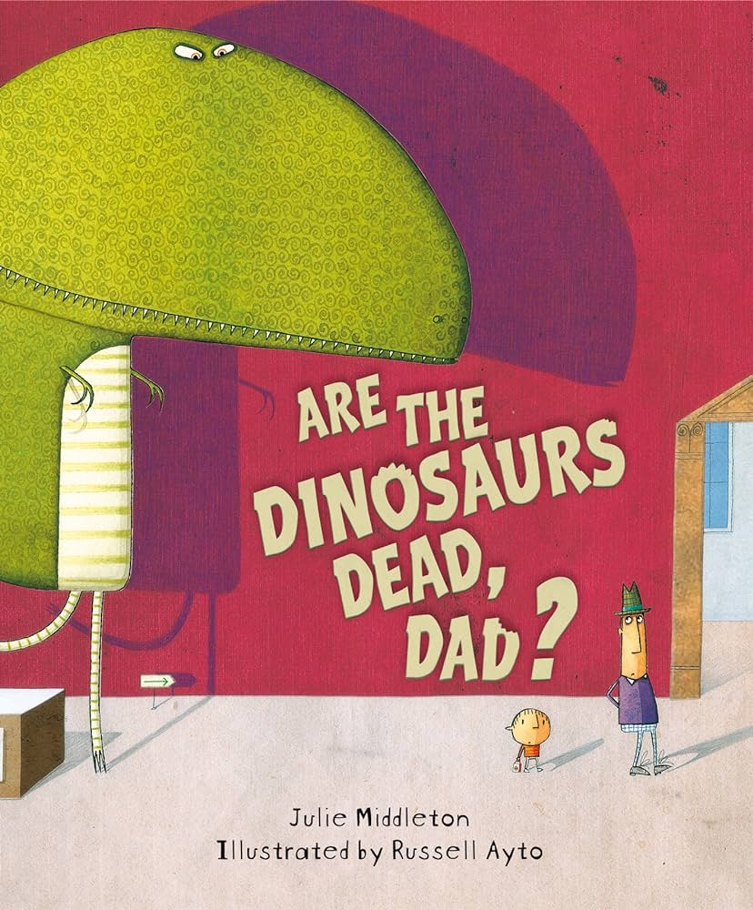
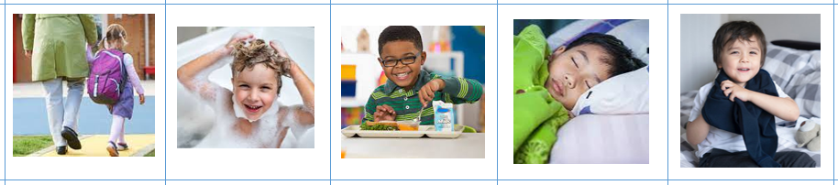
Friday 12th January 2024
Peek at the Week
Are the Dinosaurs Dead, Dad?
Reception have all had a brilliant first week back! We have read the book Are Dinosaurs Dead, Dad? by Julie Middleton. Dave and his Dad visit a Dinosaur Museum so that Dad can prove to Dave that dinosaurs are extinct. Dave is not so sure because there is evidence to the contrary. Are the dinosaurs still alive? The children have visited Drawing Club and used their imagination to draw their own T-Rex characters and have thought of some fantastic ideas of how to trap a dinosaur. The children thought of words and number codes to activate the magic button which makes their drawing come alive! We are sure they can tell you more! They have also had great fun fossil hunting! The children used paint brushes to carefully brush away the soil to reveal the skeletons, fossils and bones - some of which matched! We have some budding paleontologists!
In Maths, we have discussed our daily routines using the vocabulary ‘first, then and next’. They have enjoyed sequencing pictures and talking to us through the activities of their day.
We are revising our school rules, and the children have been brilliant at remembering what we need to do to be Ready, Respectful and Safe; such as not running in the classroom, being kind to others, listening to adults and children when they talk to you and looking after the books and toys that we play with inside and outside the classroom.

Slide 2
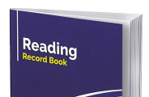

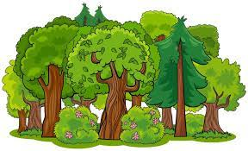
Please Read Every Night
Please remember to read every night to receive 2 stickers a week. One sticker is for reading every day and the second sticker is for bringing their book and Reading Record into school. Children who read a little bit every day make the most progress.
Forest School
We are very grateful to all the parents who volunteer to help with Forest School on a Friday morning. I know they find it a rewarding experience, but don’t take our word for it, as them! We have some parents who come regularly and some who come when they are available. It can be lovely to see some of the activities that are available to the children . If you would like to find out more or volunteer to support the children at Forest School, please contact Annabel (email at the bottom of the page) or talk to your clas rep or teacher.
Dip and Do
How can you be Ready, Respectful and Safe at home?
Choose Saturday or Sunday. Can you describe what you did on that day using the words ‘first, then and next’?
Important Dates
Maths Early Bird: Wednesday 24th January, 8.30-9:15am
You are invited to join your child as they come into class. We will set up a selection of different Maths based games to showcase the kind of activities you can play at home to support your child.
Last day of half term: 9th February Finish 3:15pm
First day back to school: Monday 19th February 8:30am
Family Phonics: Tuesday 20th February, 8:30-10:am
We would like to invite families to come and watch a class, Little Wandle phonics session. The phonics will be finished by 9:30am and the children will then be learning independently. You are welcome to stay until 10:00am and join your child as they learn inside or in our outside area. If you need to leave earlier, please make sure your Teacher or LSA knows you are going.
Contacts
If you would like to contact any of us by email. We will reply as soon as possible within school working hours.
Mrs Annabel Glover-EYFS lead/Nursery aglover13@suttonmail.org
Miss Rhian Lilley - Silver Class rlilley2@suttonmail.org
Mrs Tammy Rich- Bronze Class trich18@suttonmail.org

Slide 3
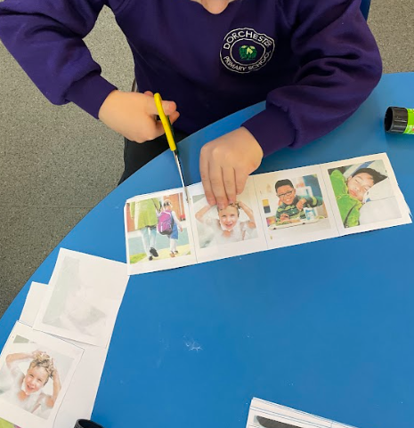
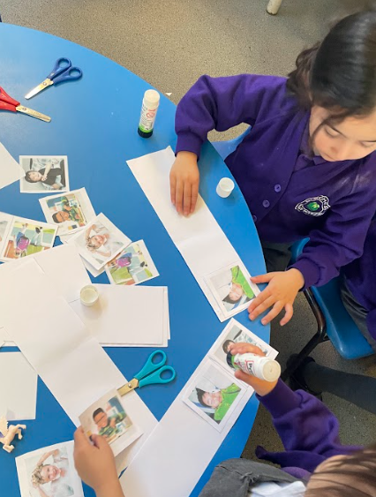
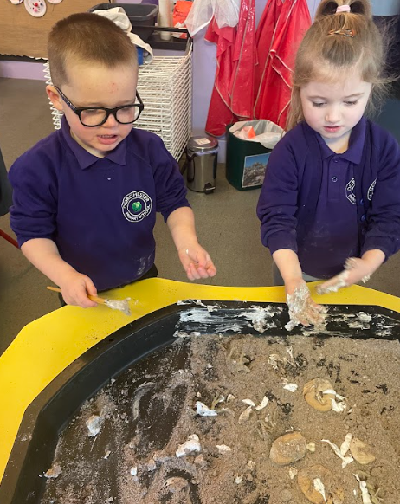
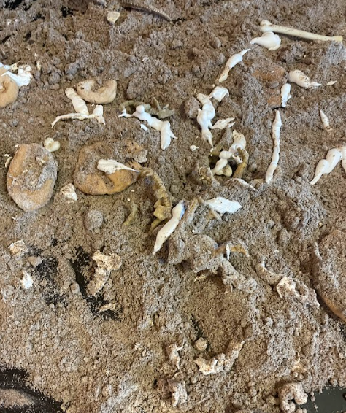
Please share these photographs with your children and encourage them to tell you what they have learnt this week.

Slide 4
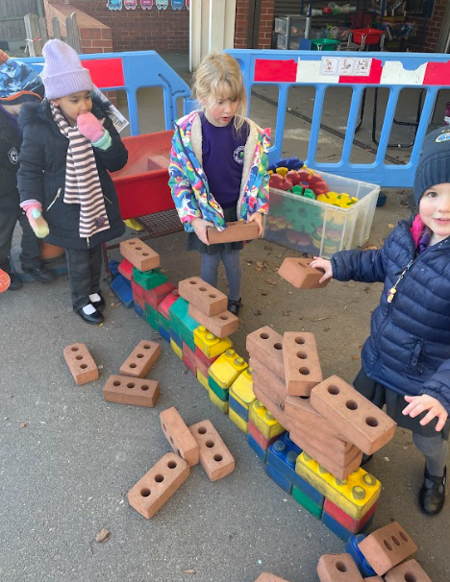
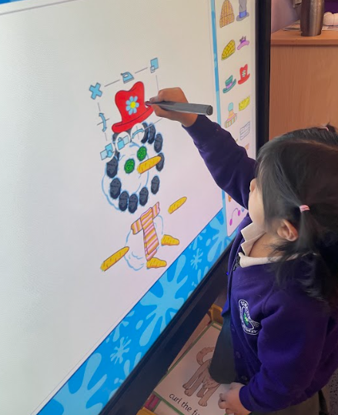
Please share these photographs with your children and encourage them to tell you what they have learnt this week.

