Slide 1
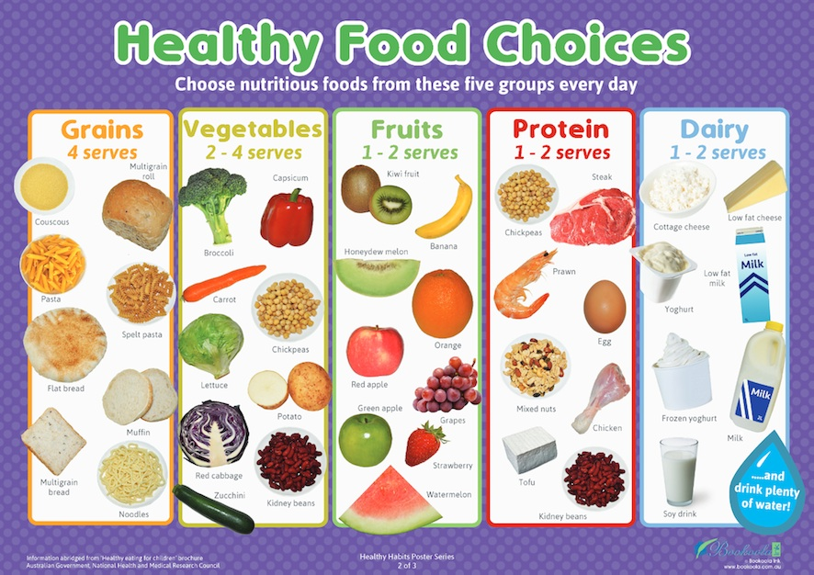
Year 1 PSHE - Autumn 1: Me and My Body
Learning Questions:
How can we communicate our feelings?
We can use the our zones of regulation display, we can use our words to explain our feelings.
Why is it important to like yourself?
To help us accept who we are
How can we live a balanced life?
Everything in moderation. Including in our diet, time we spend on electronics and sleep
How can we make choices about the food we eat?
We can decide whether the food is a food that you can eat some of, or more of
What does privacy mean? What should we keep private, and why?
There are different types of privacy: personal space, parts and information. We keep them private to protect ourselves
Vocabulary
Managing feelings | Privacy
Balanced lifestyle | Health
Learning Threads
Connectivity
RESPECT (school values)
Exploration
Influence
Challenge:
Can you design a poster on living a balanced and safe life?

Slide 2
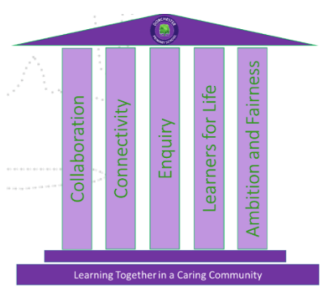
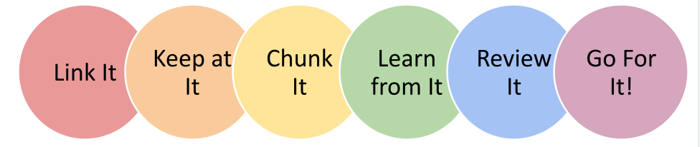
Year 1 PHSE - Autumn 1: Me and My Body
Link to PSHE Association statements:
Learn:
about what keeping healthy means; different ways to keep healthy
about foods that support good health and the risks of eating too much sugar
about why sleep is important and different ways to rest and relax
about different ways to learn and play; recognising the importance of knowing
when to take a break from time online or TV
Learning Threads
Connectivity
RESPECT (school values)
Exploration
Influence
Pillars
Collaboration:
Starting to consider and evaluate different viewpoints, attending to and building on the contributions of others.
Connectivity:
Being encouraged to link what they read or hear read to their own experiences
Threads
Connectivity
RESPECT (school values)
Exploration
Influence

