Slide 1
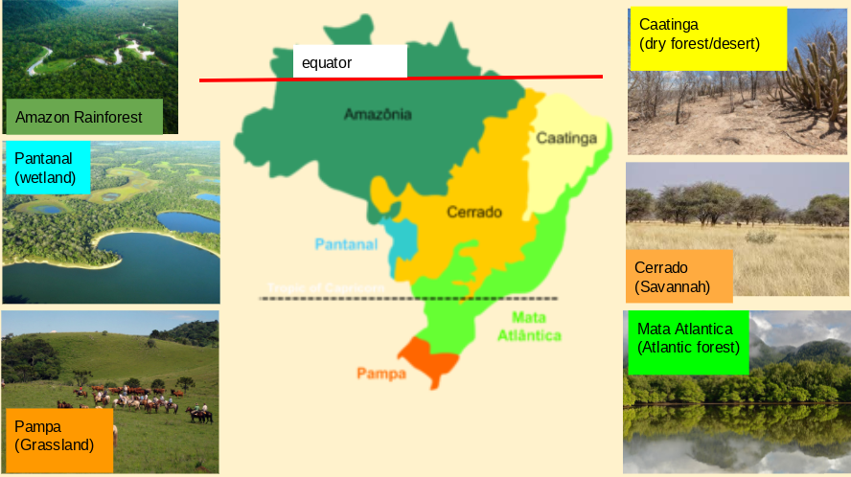
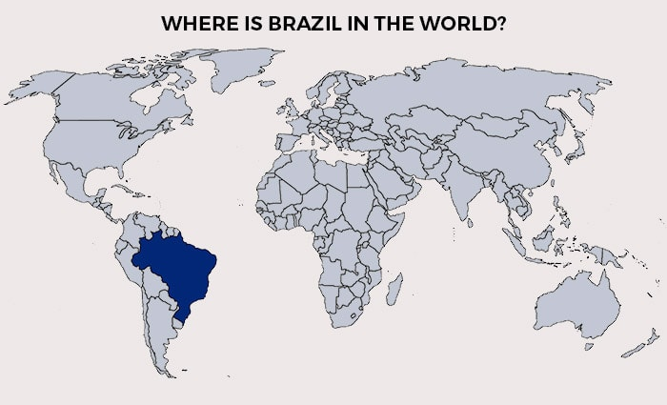
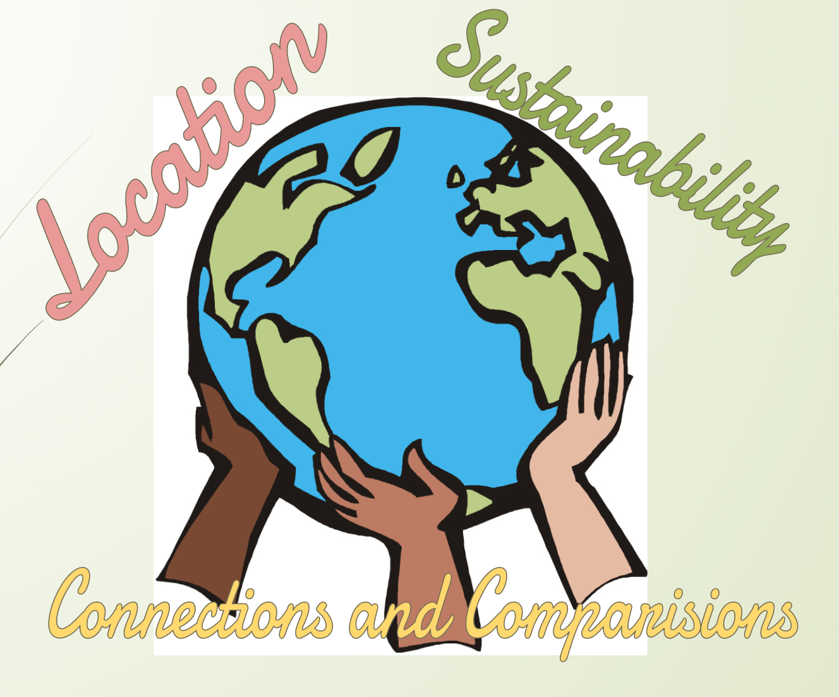
Brilliant Brazil
Can you describe the location of Brazil within South America and its physical features, relating it to the UK?
Top of South America, near the Equator in the Southern Hemisphere. 5500 miles from UK. (8850 km) 5th largest country by landmass and 7th most populated. Tropic of Capricorn passes through too. 6 different environmental zones
Where are the major cities located and how do Brazilians earn a living?
Located near sea. 90% in service sector.
Can you explain where the rainforest is located and how the layers differ?
Located in North near Equator.
Emergent layer, canopy, under storey, first floor
Is deforestation always negative?
Coffee, chocolate, medicines, spices, fruit, nuts,
agriculture, unsustainable forest management, mining, infrastructure projects and increased fire incidence and intensity.
Can you describe the similarities and differences between Brazil and the UK?
Different locations affect climate. UK is more wealthy and further ahead in equality. Opportunities are better in UK.
Challenges!
Whose responsibility is it to save the rainforest? Why?
Why is Portuguese the official language of Brazil/
Vocabulary
Equator | climate | sustainability | deforestation
Tropic of Capricorn | wetland | savannah | economy

