Slide 1
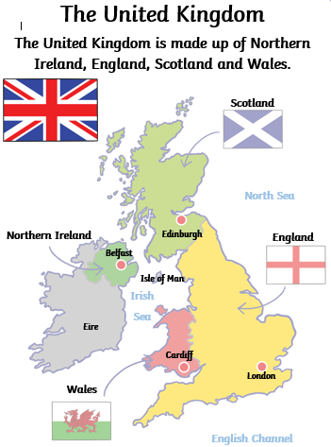
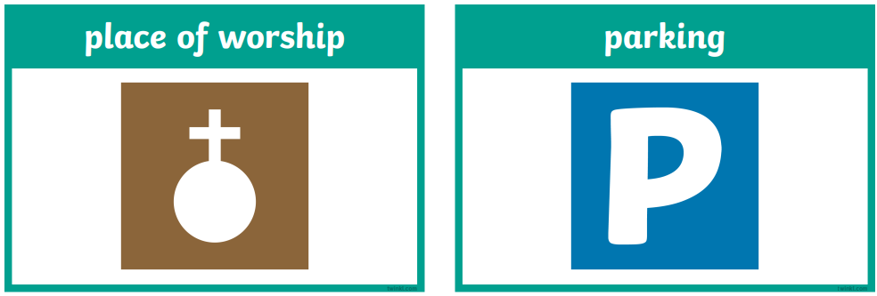
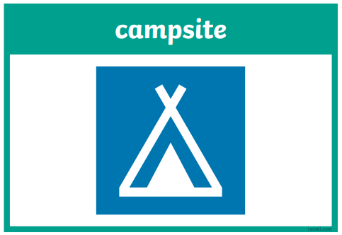
Where in the world are we?
Learning Questions
What are the countries that make up the UK, and what are some of their unique features?
England, Scotland, Wales and Northern Ireland.
What seasons do we have in the UK and how is our climate changing?
We have 4 seasons; autumn, winter, spring and summer. It is getting warmer.
What features can you identify on the map and why are they used?
Map symbols are used instead of words to make maps easier to read.
What human and physical features are on the school grounds and how can they be improved?
Our school has mostly human features as it is in an urban area.
What key symbols can you include on your map and why are they important?
Learning Threads
Location
Connections and Comparisons
Sustainability
Vocabulary
Challenge!
Create your own Atlas of the World
human | physical | compass | map

