Slide 1
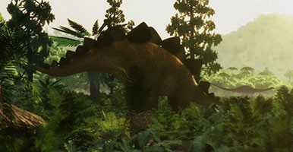
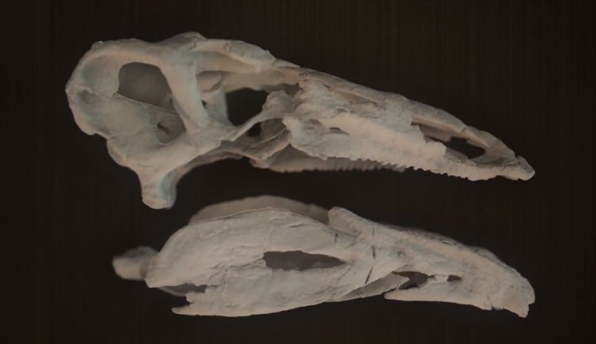
Learning Questions
How do we know that dinosaurs existed?
People studied fossils and learnt about how and when they lived
Who is Mary Anning and did she influence our knowledge of dinosaurs?
Mary Anning was a fossil hunter who discovered, at the time, the largest dinosaur skull. She found the first plesiosaur
How did dinosaurs change over the years?
Most dinosaurs grew over time into enormous creatures but some evolved into birds. There were three time periods: jurassic, triassic and cretaceous
What are the similarities and differences between dinosaurs?
The varied in speed, size and diet
Where did dinosaurs live and what did they need to survive?
They lived across the world. Some flew while others stayed on land and some lived in water. They needed, food, water, air and shelter in order to survive
How did historians find out the diet of dinosaurs?
Scientists looked at dinosaur poo, fossilised stomachs and dinosaurs’ teeth
Challenge
Can you explore where the largest and smallest dinosaurs lived?
Digging for Dinosaurs
Palaeontologists study fossils to find out information about dinosaurs.
Dinosaurs are split into different groups.
Herbivores
Carnivores
Omnivores
They lived through different periods of time.
The Triassic period
The Jurassic period
The Cretaceous period
Dinosaurs are a group of reptiles who dominated the land for over 140 million years.
Dinosaur Workshop and WOW Day
Vocabulary
fossil | herbivore | carnivore | omnivore

