Slide 1
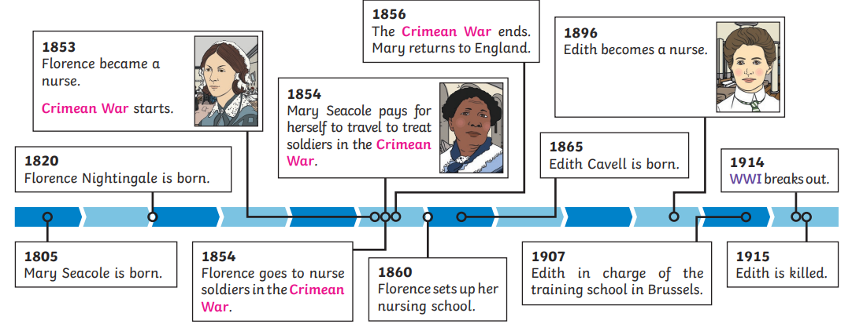
Maggots and Medicine
Vocabulary
Crimean War | A war between Russia on one side and Britain, France, the Ottoman Empire (Turkey) and Kingdom of Sardinia on the other.
WWI | World War 1
allies | Countries that fight together against other countries
treason | The crime of betraying your country by helping the enemy.
Learning Questions:
What does it mean to be significant?
What are hospitals like? How do they compare to hospitals in the past?
Who was Florence Nightingale and why was she significant?
Who was Mary Seacole? What makes her similar/different to Florence Nightingale?
What are the careers we can have in medicine and how have they changed over time?
Challenge:
Can you see any ways modern medicine was influenced by Florence Nightingale or Mary Seacole?

