Slide 1
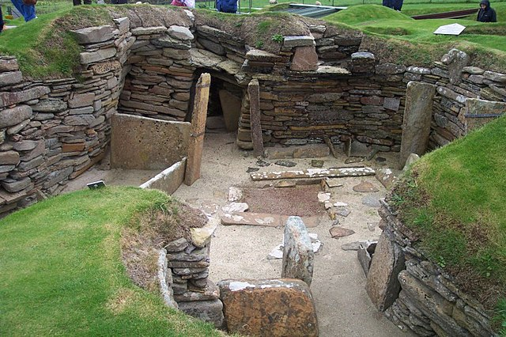
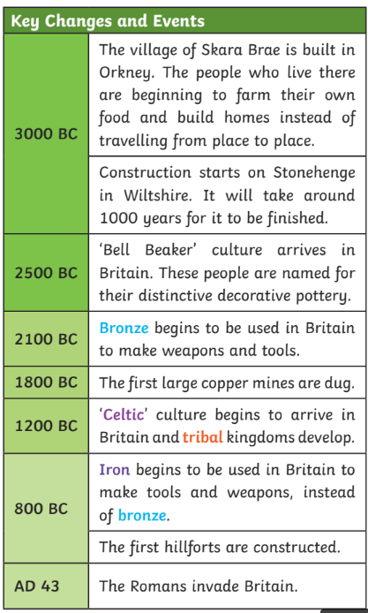
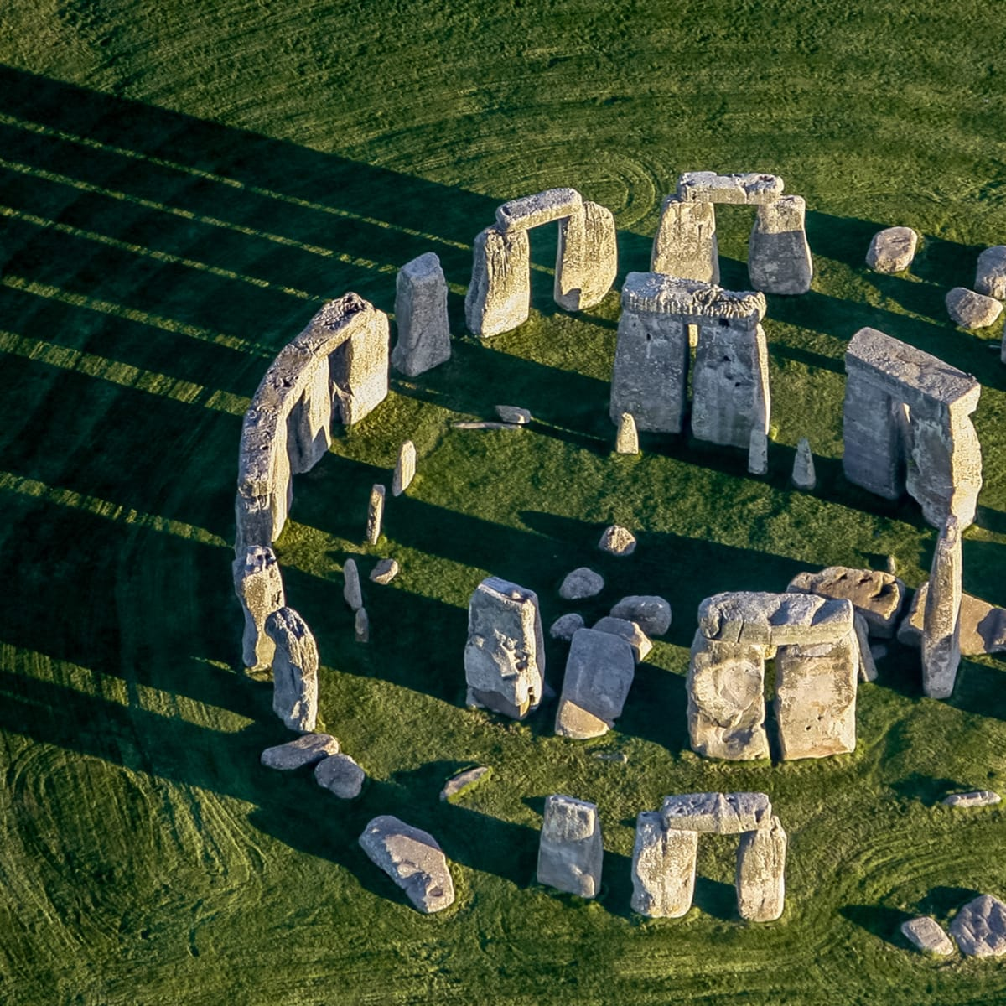

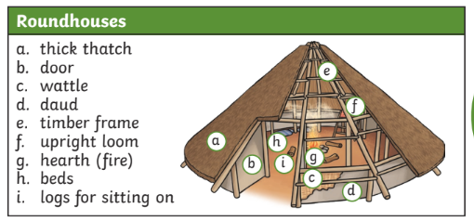
Stone Age to Iron Age
Q - How does life in the Stone Age to Iron Age still affect our life today?
The Stone Age is named after the stone tools that the earliest humans
used to help them survive. They used them to kill animals, such as mammoths, for their meat, bone marrow and skins. The bones were also useful for making tools, such as needles to sew skins together.
People in the Stone Age moved around from place to place with the seasons, in order to keep safe and warm and to follow the animals they hunted.
Skara Brae, Orkney, Scotland
Stonehenge, Wiltshire, England
People in the Bronze Age and Iron Age lived in roundhouses. These could be very large and would have housed many people. One household might have had two houses, one for living and one for cooking and making things.
In the Iron Age, these houses were sometimes rectangular and were often gathered in farming communities on hills. These were known as ‘hillforts’.

