Slide 1
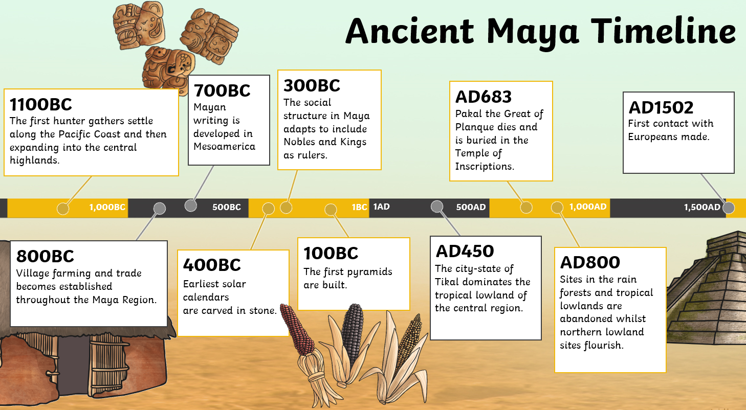
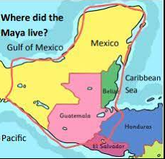
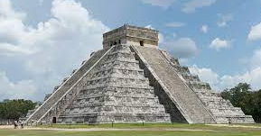
Marvellous Maya
Learning questions:
The Maya were an ancient civilisation. What do you understand by this, where did they live and when?
Group of people who have an agreed system of laws, beliefs and customs. Central America between 2500 BC-1517 AD.
Why was Chichen Itza so important to the Maya?
Site of religious significance, astronomical importance and people lived there. Iconic stepped pyramid.
How did the belief system influence everyday life?
Religion influenced every aspect of daily life. They believed in many nature gods, with some more powerful than others. Kings acted as intermediaries between the gods and the people. Most important god was Itzamna - creator and gave them writing and the calendar. Priests performed sacrifices at top of temples. Creation story is based on maize. Hieroglyphs
What was everyday life like for the Maya?
Huts made of stone, mud and wood. Clothes - children were naked until 5 years old. Boys received loin cloth and girls, a tunic. Farmers, hunters, craftsmen, artists, merchants, architects, builders. Women worked in the home. Children of nobles were educated.
How did the Maya diet compare with that in the UK?
Maize, chilli, chocolate, avocados, sweet potato, tomatoes, guava
No junk food or from other nations
What happened to the Maya? (invasion and exploration)
European invaders and explorers brought foreign diseases against which they had no defence. They also forced them to become Christians, used weapons and treated them cruelly if they didn’t obey. Some Maya do still exist - 31 Mayan languages exist - discrimination.
Challenge
If the Maya still existed, how might their lives look today?
Vocabulary!
Maya | god | civilisation | similarities
religion | Pok-a-tok | sacrifice | differences

