Slide 1

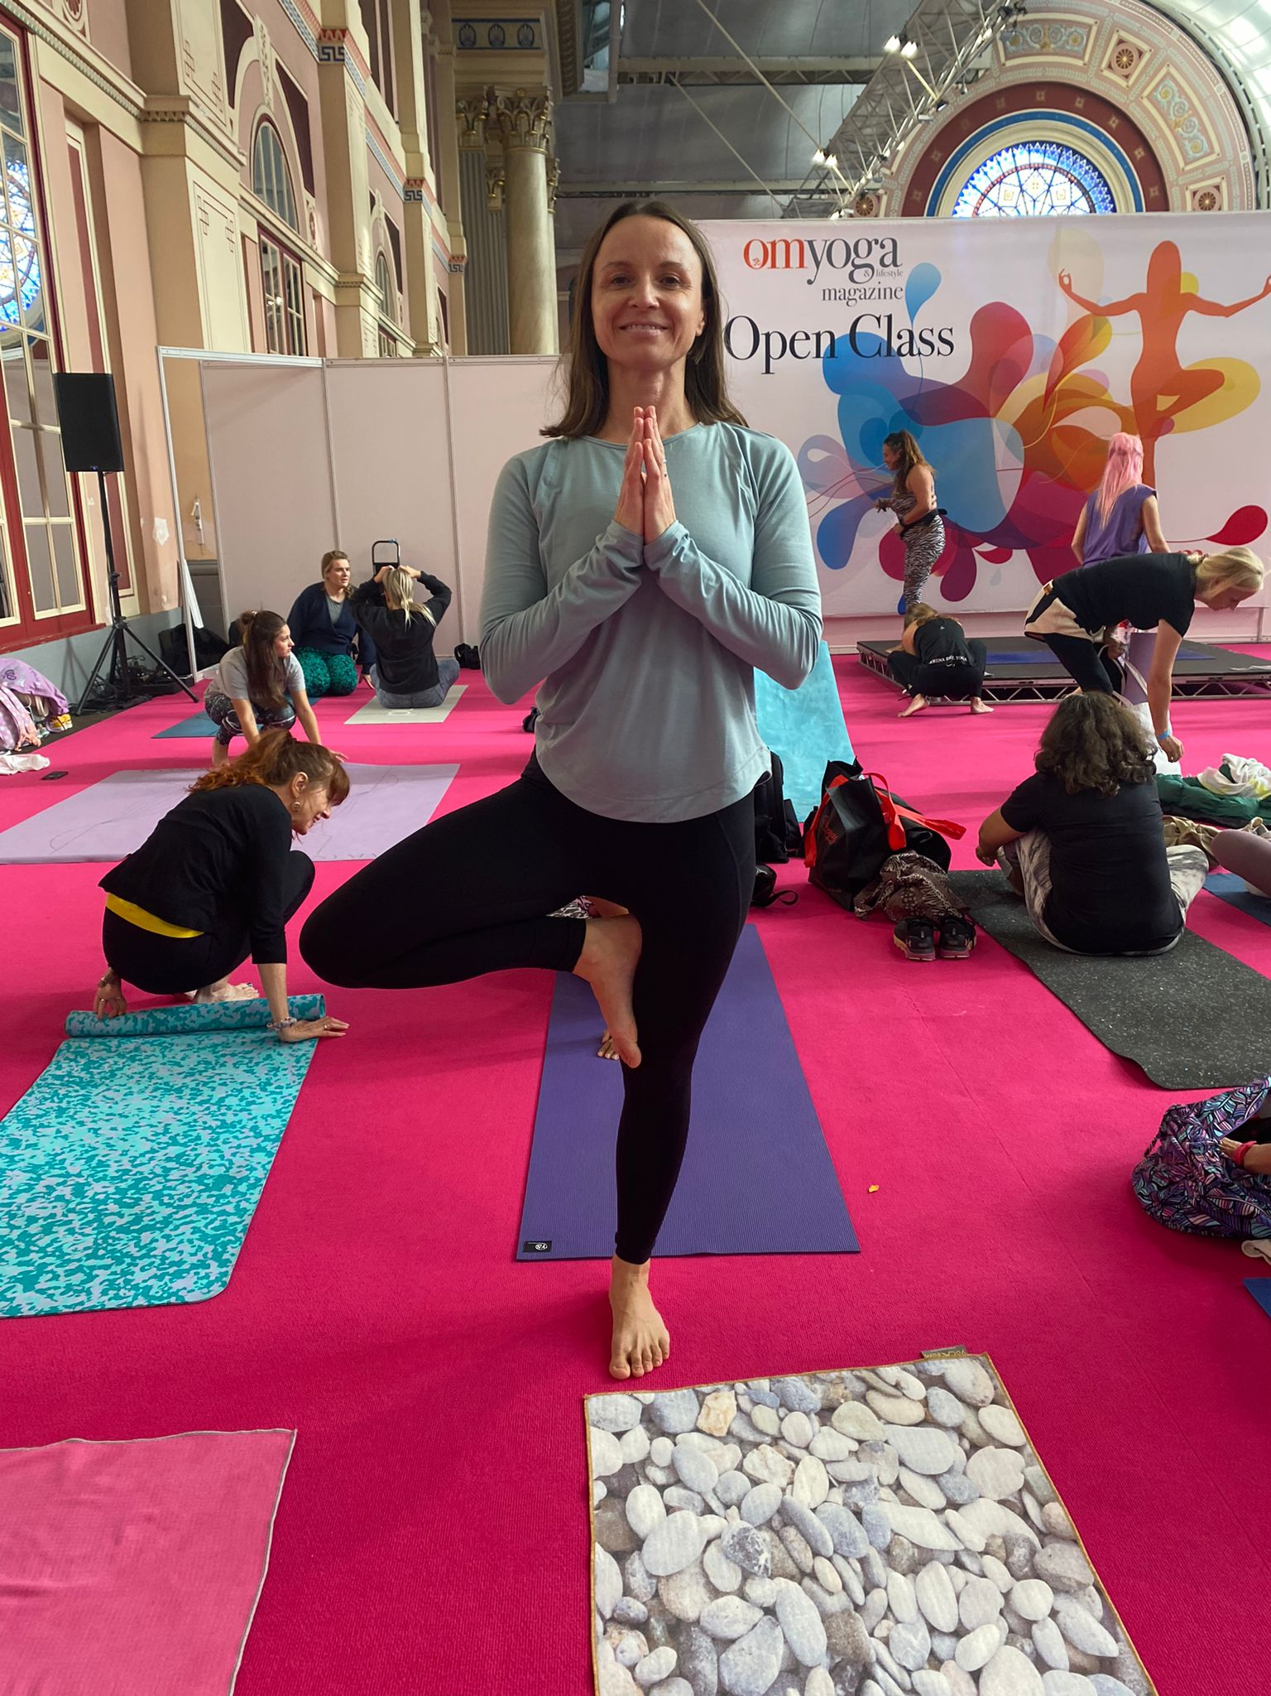
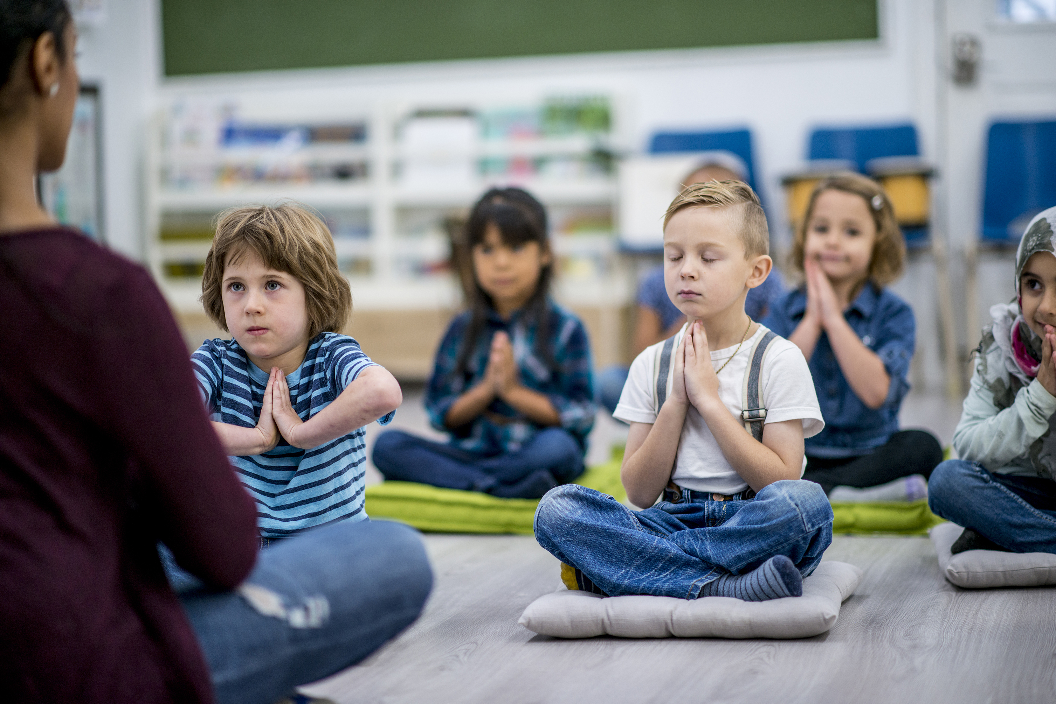
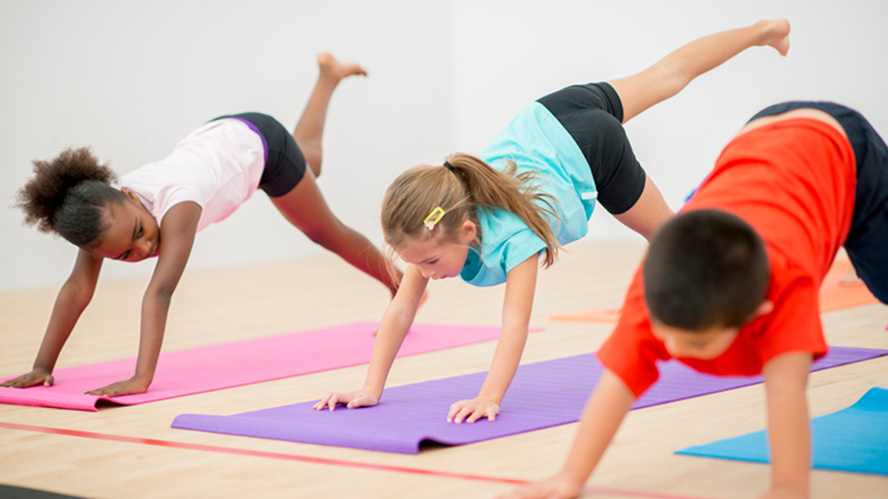
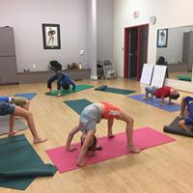
Children’s Yoga in Dorchester School
Mondays- Years 3, 4, 5, 6
Tuesdays- Reception, Years 1, 2.
After school start at 3.15pm-4.15pm
Benefits of yoga for children :
“Yoga helps to enhance flexibility,
strength, coordination and body
awareness in children. In addition , their concentration and sense of calmness and relaxation also improves.”.
Children’s yoga is delivered trough seasonal stories, music , movement, fun games , developing social skills, working as part of team.
weeks in total , £8.50 per session per child
I offer siblings discount 50% off
Contact Martina for more info:
Email: martina.grace@icloud.com
Mobile: 07792164 888

